Slide 1

Stay tuned
Is about to begin...

Slide 2
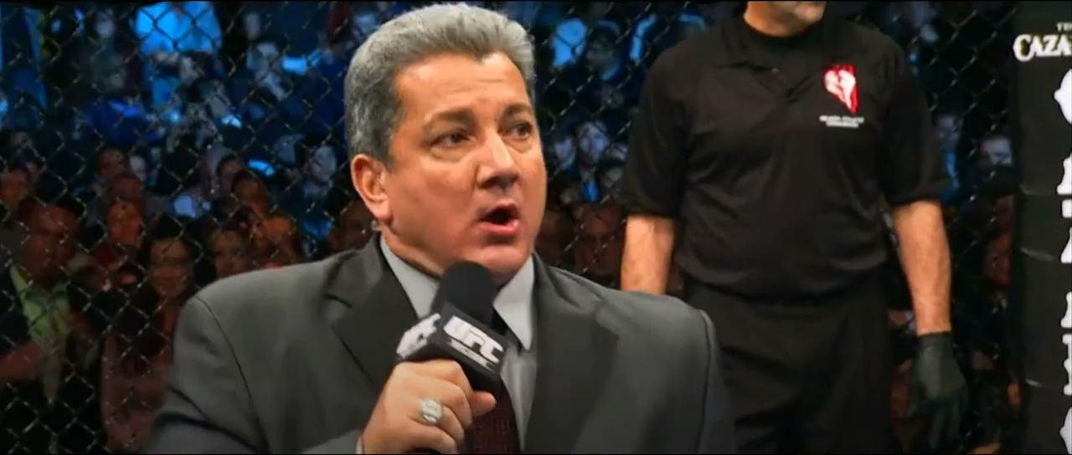

Slide 3
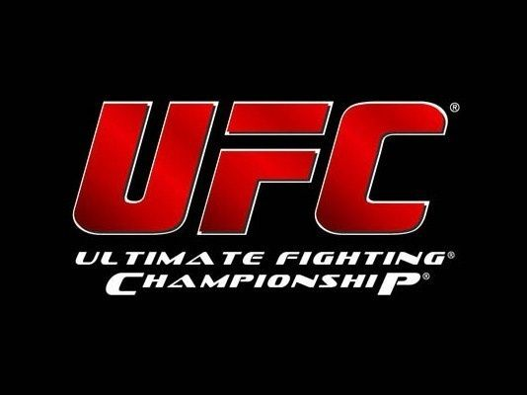
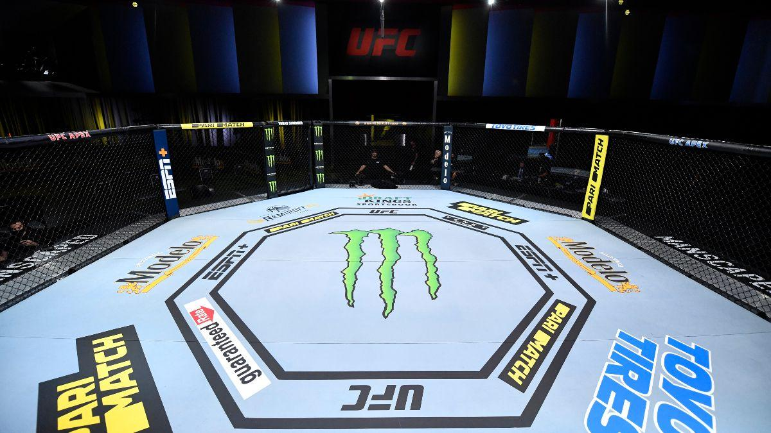
Ladies and Gentlemen
IT’S TIMEEEEE!!!
Notes:
Priti:
Ladies and Gentlemen.. IT’S TIMEEEEEE!!
We all love to see a good match. Whether it’s basketball, tennis, gymnastics, or even chess.
As fans of any sport, you may find yourself trying to predict the outcome of an upcoming match. (CLICK)
(Like many others, the nature of fighting can be very unpredictable. The advantage or the outcome of a fight can change in a split second.. But then again, that is what makes it so interesting! (CLICK))

Slide 4
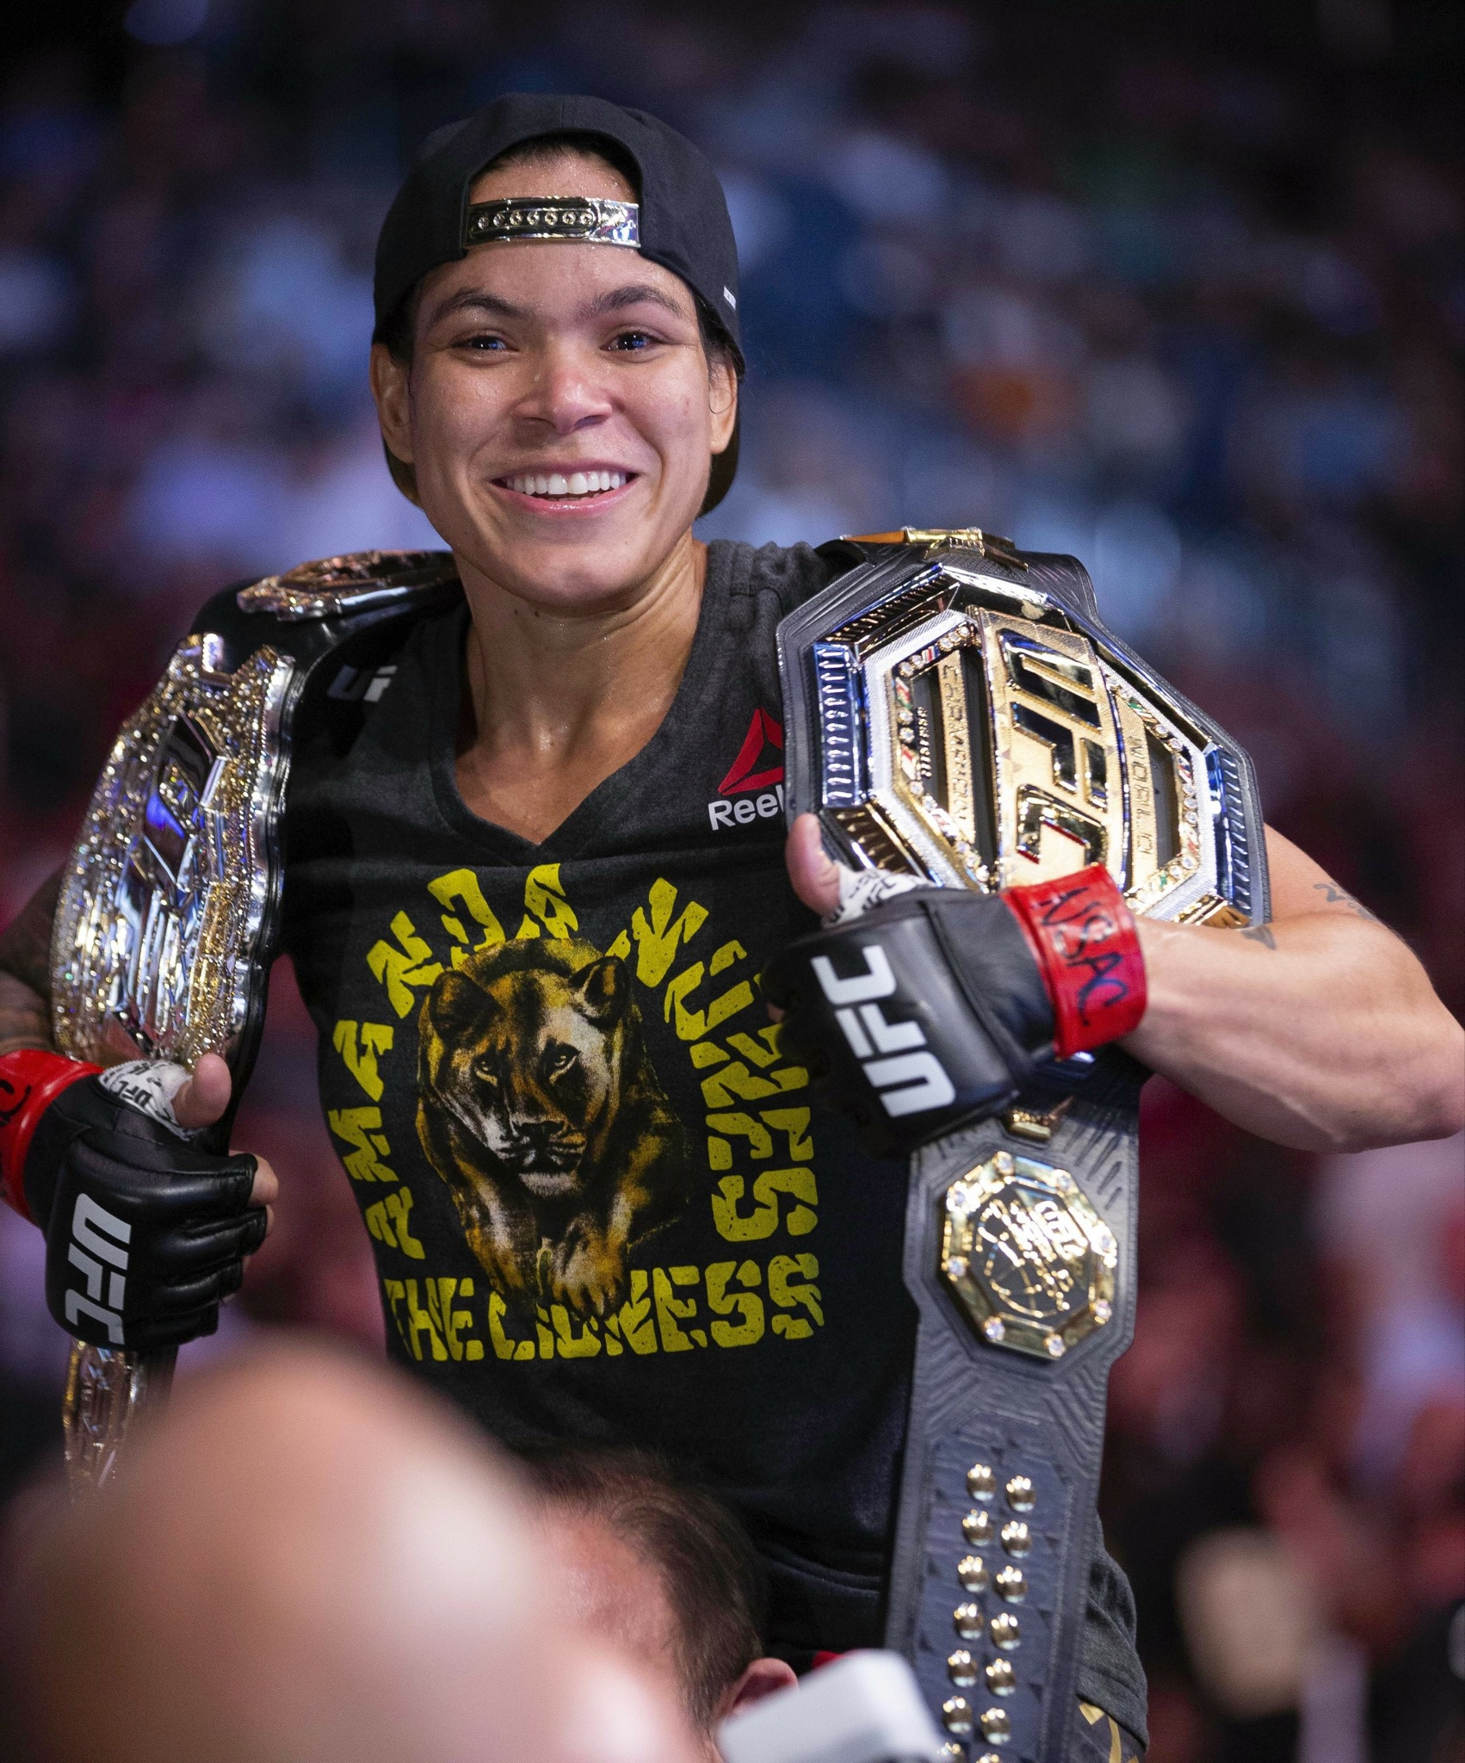


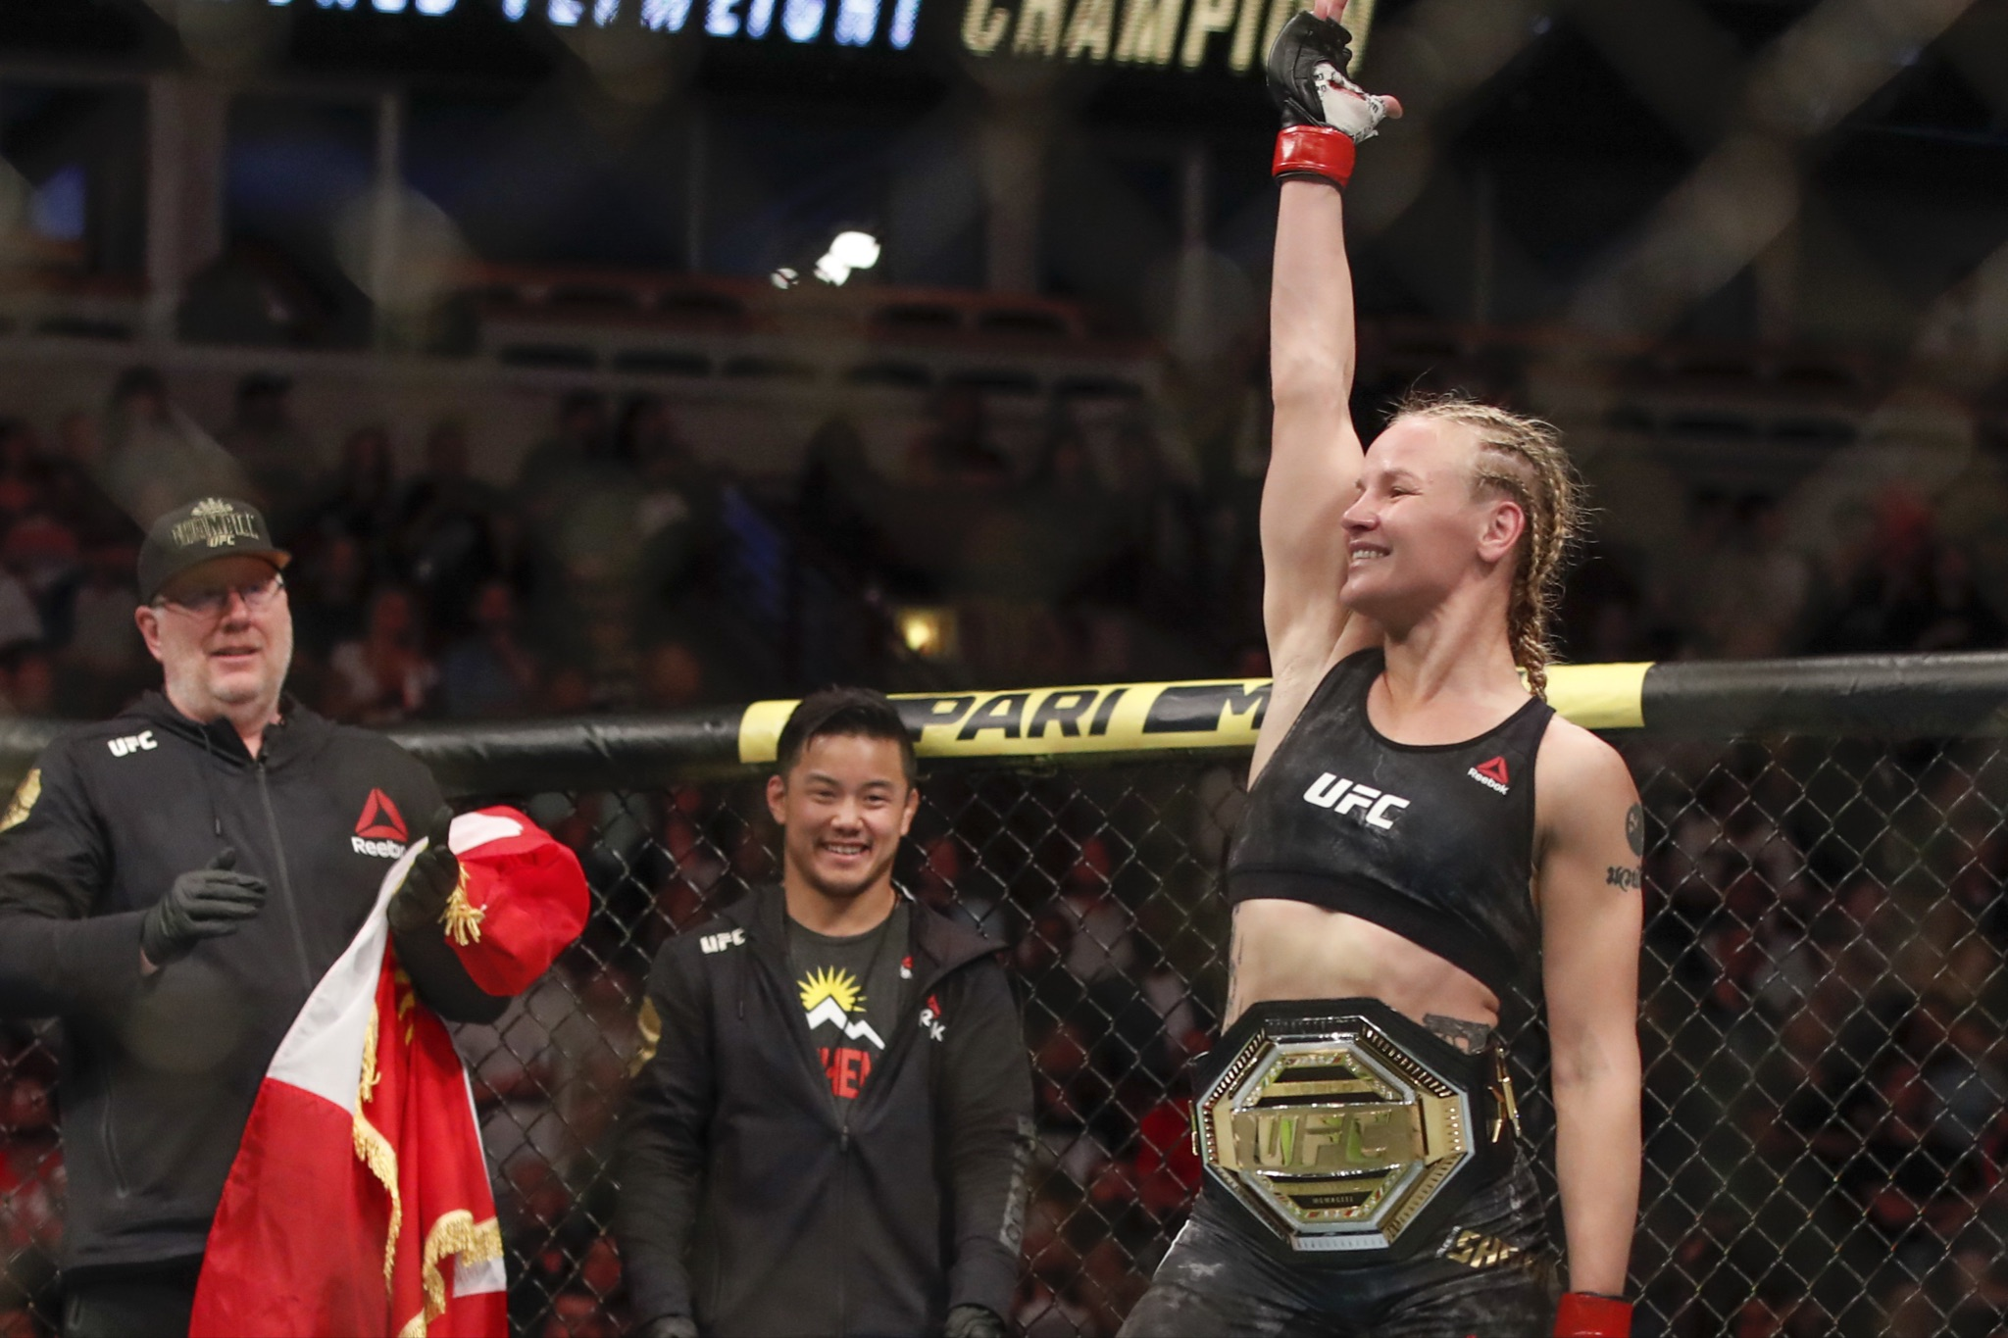
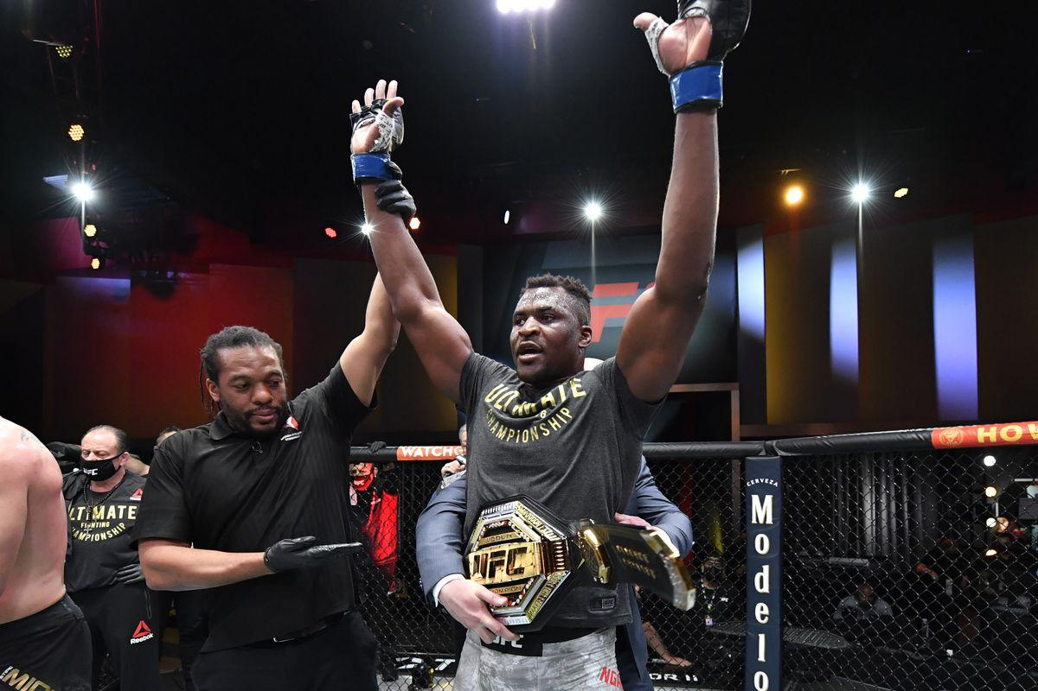
Notes:
So, if we were to witness some of the best UFC fighters go against each other, like..
(CLICK) Conor McGregor (CLICK) vs (CLICK) Francis Ngannou (ninganu)
... or…
(CLICK) Amanda Nunes (CLICK) vs (CLICK) Valentina Shev chenko
Who would you root for? Place your bets! (CLICK)

Slide 5
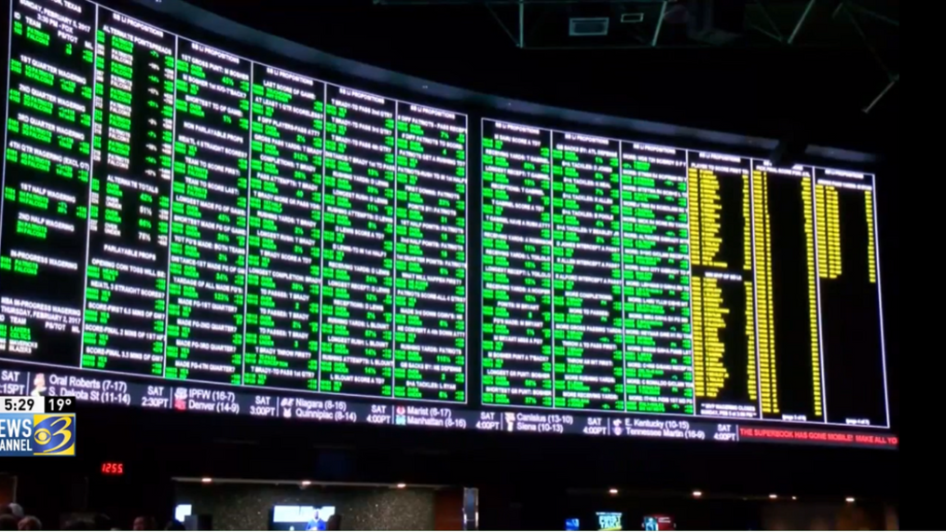
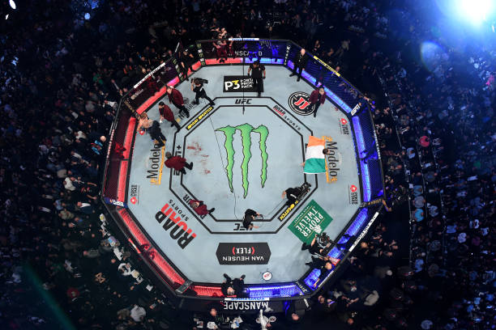
$155 billion
Notes:
Sport betting is a (CLICK) $155 billion (dollar) industry and fight matches rank among the top in the industry!
(Gambling and “The Fight Game” have always gone hand in hand. There are many analysts that make a living off of predicting fight outcomes based on the eye test or on data that has no proven correlation to actual wins. On the other hand, a casual fan is typically basing their predictions on the most basic statistics that are provided by the broadcast.)
What would you need to know before placing your bet..? (CLICK)

Slide 6
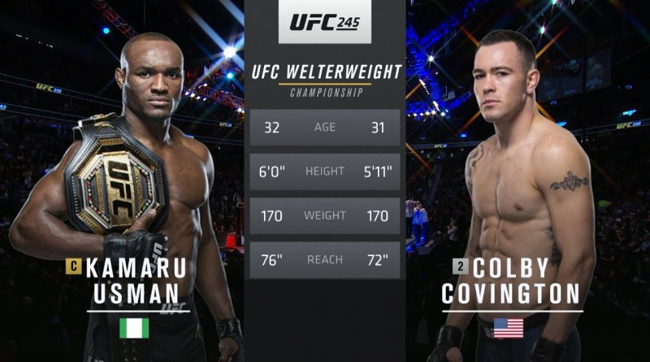

Notes:
Mixed Martial Arts (MMA) fighter statistics involve everything from skill centric values such as wins and significant strikes to physiological measurements such as height and reach. There are over 100 features that can be analyzed before any given fight..
So where's the edge?
Well, my name is Priti, and along with my teammates, Cesar, Andrew, and Mattie.. we are TEAM 3!!
(CLICK) Our goal is to see if there is a way to apply modern machine learning techniques to historical fight data to best understand which statistics, or features, are most relevant in order to find trends and predict the outcomes (win/draw/loss) of each fight.
So, INTRODUCING… (CLICK)

Slide 7
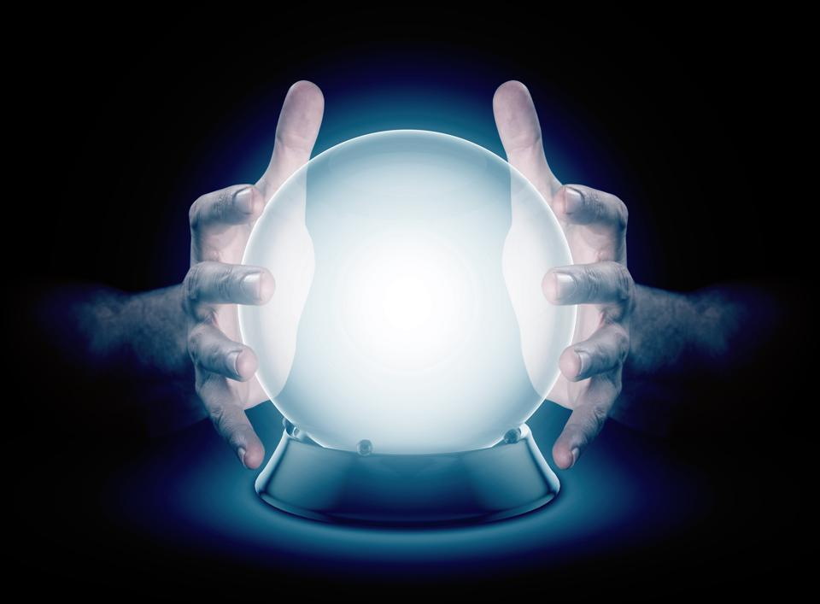
UFC Match Outcome Predictor
A quest to predict the unknown
Notes:
Cesar Greeting: “Welcome to our “UFC Match Outcome Predictor” presentation. In the Data Analytics World we all know Data Scientists are king...but what about, hypothetically, in the Octagon? As Bruce Buffer said it's time to find out”
(CLICK)

Slide 9

Quest for W’s
The What, When & Where of Winning
Just like fighters strive to win, we strive to harness the power of data science to help us win by answering complex questions.
Our quest is to explore if there is a way to wrangle and distill data such that we are able to determine the future outcome of UFC fights based on previously fought bout data metrics.
Notes:
Cesar: “In our quest to get the ‘W’, we aspire to harness the power of data science to help us win by answering the following questions.” (CLICK)

Slide 10
What?
Why?
Where?
01
02
03
Topic:
Our Process:
Source:
Use data and fighter statistics to create an educated prediction on who will win the fight.
As fans, it would be interesting to best predict who will win a fight.
We acquired a dataset from UFC saved in Kaggle.com
Notes:
Cesar:
“What? To use data science to formulate an educated prediction on the winner of a fight”
“Why? Thats easy...Because we actually are die-hard fans!”
“Where? UFC provided the fight data via a collection of datasets found in Kaggle”
(CLICK)

Slide 11
What We Plan On Answering
1. What are the top 5 fighter metrics that contribute to winning a UFC match?
2. Which of the fighter metrics carry more weight than the others?
3. How much do biometric physical factors, i.e. age, height & weight affect the outcome of the match?
4. Does having a higher rank predict the outcome?
5. Do the number of win streaks necessarily predict a higher chance of winning?
Notes:
Cesar: “Here are the 5 questions we plan on answering by the end of the presentation:
1. What are the top 5 fighter metrics that contribute to winning a UFC match?
2. Which of the fighter metrics carry more weight than the others?
3. How much do biometric physical factors, i.e. age, height & weight affect the outcome of the match?
4. Does having a higher rank predict the outcome?
5. Do the number of win streaks necessarily predict a higher chance of winning?”
(CLICK)

Slide 12


Tools and Techniques
Data & Preprocessing
Analysis & Viz
PostgresSQL Database
Python
Pandas
SciKit-Learn
Google Slides
Tableau Public
Label Brushing
Filters
Heat Intensity
Notes:
Cesar: “Handing over to Priti”
Priti: “In order to answer these questions, we decided to use a PostgresSQL database to house our data. For the preprocessing and modeling stages, we utilized Jupyter Notebooks, where we scripted in Python, along with the Pandas and SciKit-Learn libraries.
As for the analysis and visualizations, we used Google Slides and Tableau Public.. which you will get a glimpse into later in this presentation. (CLICK)
Interactive Elements --
Chart with label brushing to allow for automatic appearance of an identifying label when cursor hovers over a particular element
Table with filters to see side by side comparison of fighter features
Heat map to show intensity to showcase intensity of fighter statistics against one another”
(CLICK)

Slide 13
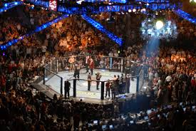

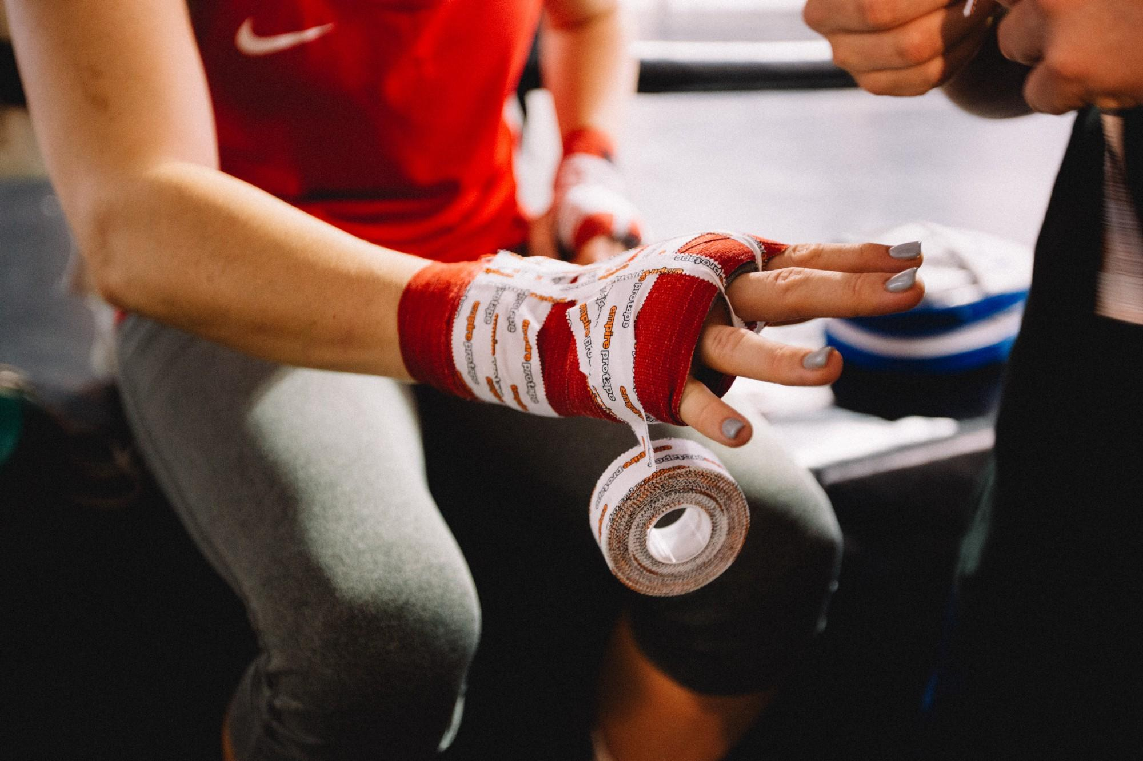
Dataset and Features
4,566
1,286
137
UFC Fights
Fighters
Variables
dating from March 2010
to Feb 2021
and their previous
bout metrics
correlating to Red and Blue fighters
Notes:
Priti: “To get started, we pulled a robust dataset from Kaggle. With this data, we were able to analyze 4,566 UFC fights dating from March of 2010 to February of 2021. This data includes 1,286 fighters and their previous fight metrics. These metrics include 137 different variables or features. So let’s get started and build the database - handing it over to you, Mattie.“
(CLICK)

Slide 14
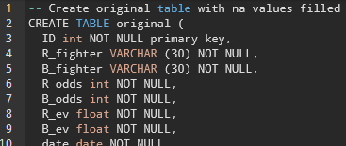
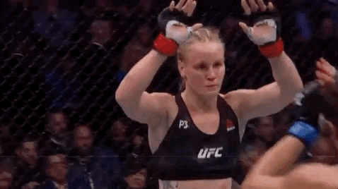
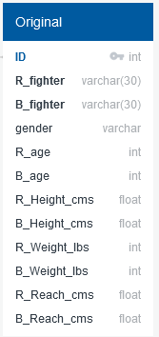
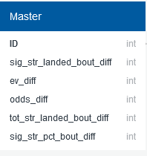
Database
Data collection and processing
Table creation and queries
Export joined data CSV
20XX
Database Creation and data import
Join of data
Notes:
The Database engine is created in python using sqlalchemy. The data pulled from the Kaggle website was previously processed and molded into a clean dataset from which to read into this database creator. This data is retrieved and executed into relational database manager pgAdmin to use the management tool PostgresSQL.
(CLICK)
Here** our processed data read into two separate tables; one called Original data and the other called Master data. Both of which were created in python and imported into pgAdmin.
Each of these focus on the two main categories we find influence match outcomes. The great question if biometric factors; seen in Original data, or skills of fighter metrics; in Master data hold the greatest influences. Some details of the above, R_fighter and B_fighter are categorized as varchars with 30 to hold names of the most common sizes. Age and weight values as well as the significant strikes, odds of the underdog or favorite fighter, total strikes landed and significant strike percent values are labeled as integers because they are whole value numbers. Floating variables used above have more precise numerical values that include a decimal place in their data. These include height and reach of each fighter measured in centimeters.
These two categories are Joined together with pgAdmin Query tools and exported as a UFC fighter_comparison csv file.
(CLICK)
(1:45)

Slide 15
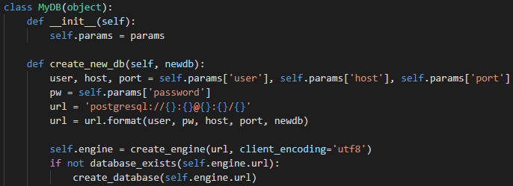
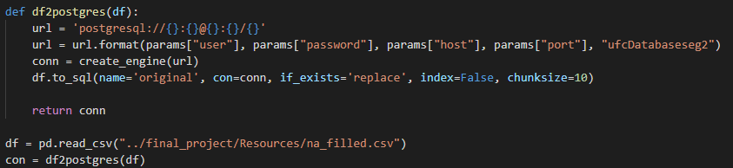
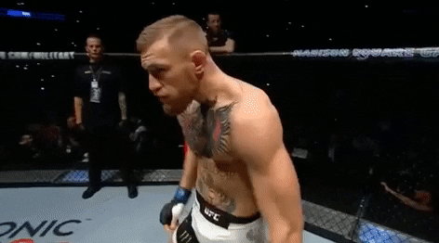
Database: how to connect dataframes in python
20XX
20XX
Import tools
Create database engine
Connect dataframe to sql
Read in csv
Sqlalchemy
Sqlalchemy_utils
Pandas
psycopg2
def create_new_db
conn=create_engine(url)
df.to_sql
df=pd.read_csv(“...csv”)
con=df2postgres(df)
Notes:
There are a couple tools used to create and connect a database in python. Sqlalchemy is used to create the engine and database. Pandas is used as pd to read in the csvs.
To create this database the params are set to connect the postgresql user, password, host, port, and new database. Then the engine creates that database.
Here a connection is created between that new database and the setup of where data will be imported.
Through pandas our csv data is imported in and read into this new postgres dataframe.
This action is performed with two separate python files, one coded for the Original data table creation using pandas reading the cleaned and na filled csv, and the second python file specialized for the Master data table reading in the preprocessed data csv. I wanted to note that the same database connection is used in both these instances so there are two separate tables, Original and Master each reading in their own csvs, living under the same database header in pgAdmin as two tables. Here the view was created to see the join made between Original and Master.
Something we could have done differently is instead of cleaning and breaking our largest kaggle data file into two separate files is to pull different csvs of data from a a different source.
(CLICK)

Slide 16
Data Exploration Phase
Blue
Red
Example: ML model could be improved by getting the differences in the average accuracy of takedowns between fighters by using a function
Function: X = “Blue corner score” minus (-) “Red corner score”
Where a negative score actually favored the Red corner fighter
Significant amount of null & NaN values
Data wasn’t curated for ML model in its original raw state
Some “noisey” non-contributing columns we later found could be stripped from dataset
Notes:
Cesar: “Thank you Mattie…….Exploring the data we found that not all data is usable in its original state. We would need to devise a way to provide the machine learning model, data, ideal for determining winning contributing factors.”
(CLICK)

Slide 17



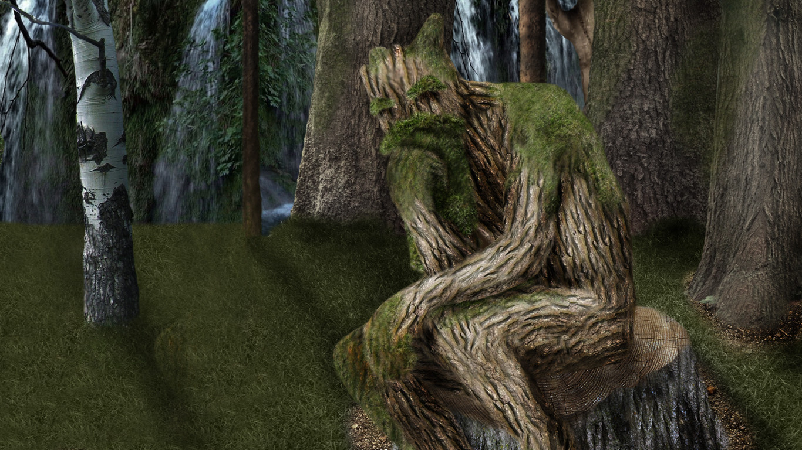
Analysis Phase
-Model Comparison
K-Nearest Neighbors
Random Forest Model
Decision Trees
Logistic Regression Models
Supervised learning algorithm
Simple, supervised machine learning algorithm
Builds regression or classification models in the form of a tree structure
Basic statistical model that uses a logistic function to model a binary dependent variable
Notes:
Cesar: “We compared the following 4 models to see which model best fits our data, research requirements and structure.
K-Nearest Neighbors
Random Forest
Logistic Regression
and Decision Trees”
(CLICK)

Slide 18
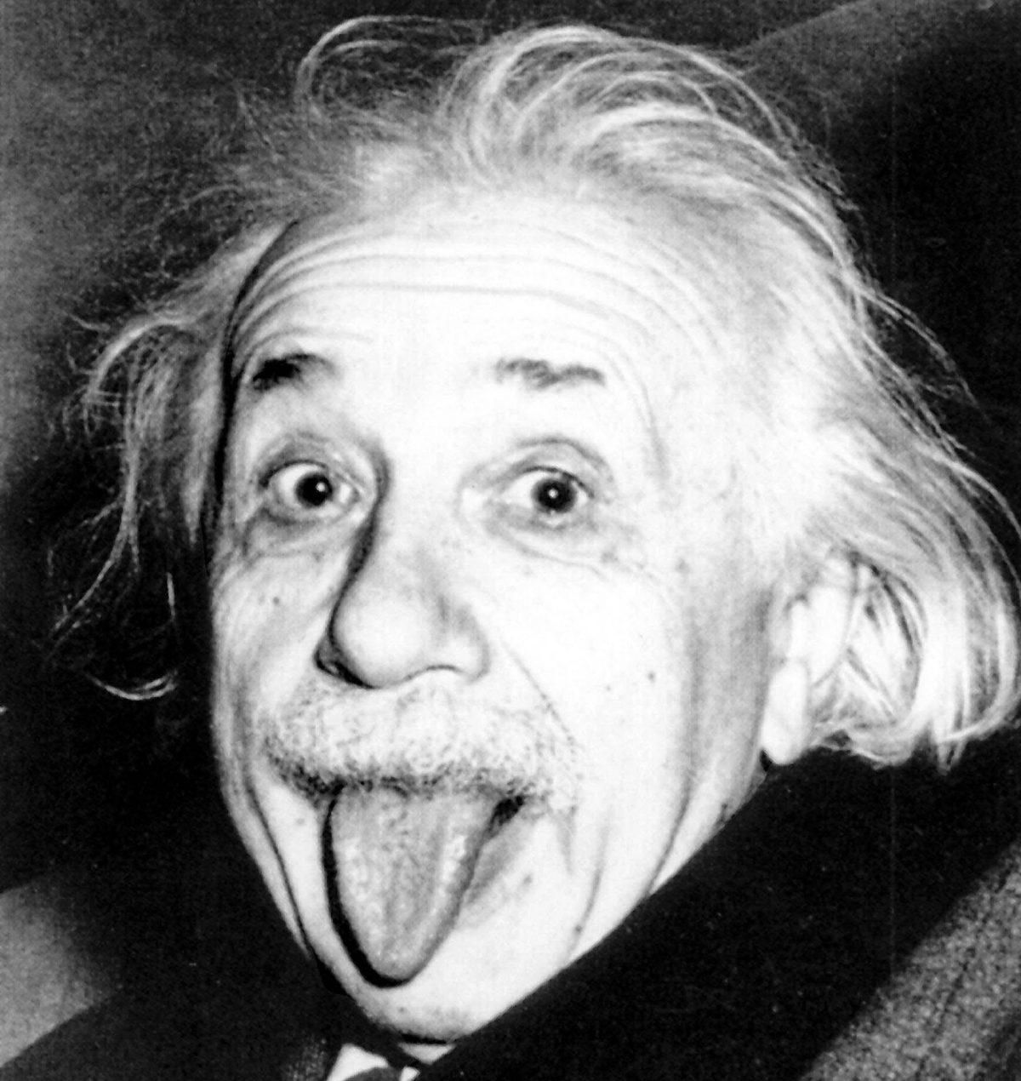
Albert Einstein
“Everything should be made as simple as possible, but not simpler.”
Notes:
Cesar: “We let Einstein inspire us with the following quote (CLICK)...
Fundamentally, a baseline is a model that is both simple to set up and has a reasonable chance of providing decent results.”
(CLICK)

Slide 19
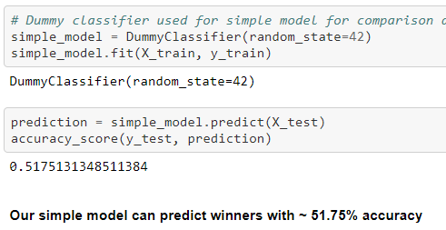
Can’t have a good model without a good base
Logistic Regression Model
For our base model we chose the Logistic Regression model
Our simple model can predict winners with the below accuracy percentage:
Notes:
Cesar:
“Just like you can’t be a good fighter without a solid base or foundation from which to work from, you can’t have a good machine learning model without first creating a baseline.
When trying to classify structured data or natural language, logistic regressions will usually give you quick, solid results.
Our simple model, without removing null values, can predict winners with (CLICK) ~ 51.75% accuracy
Since nobody is truly satisfied with a 50/50 chance of winning, we had some tweaking to do to improve the accuracy of the baseline even before comparing other new models.”
(CLICK)

Slide 20
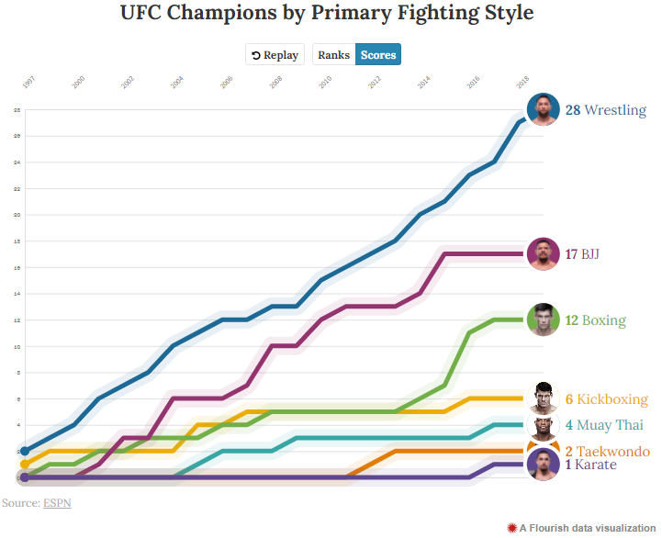
Fun Fact
Most UFC champions have one base in common:
Strong Wrestling Background
Notes:
Since UFC started in 1993 there have been 190 crowned champions these past 28 years
28 UFC champions, roughly 15% of all champs, have come from the sport of wrestling, making it the most prevalent base for UFC gold
Moral of the story: “No matter how hard a kick boxer trains his wrestling when he's in his twenties and ready to start MMA, he will likely never be able to stop the takedowns of a guy who's been wrestling since he was a kid.”

Slide 21
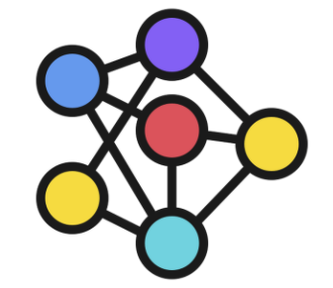
The Chosen Two
Both models perform best with large datasets
Neural Network Models
Random Forest Model
Great for images, audio or text.
Prerequisites include filling missing values, converting categorical data into numerical and scale features into the same range or at the very least similar.
Seamless feature engineering transition to improve accuracy
Great for tabular data
Automates missing values present in the data.
Requires less preprocessing and the training process is simpler.
Reduces overfitting by aggregating several decision trees which helps improve accuracy and reduces error due to bias.
Notes:
Cesar: “In the end we stuck with the Neural Network and Random Forest Models due to their ability to handle large datasets the best…...And now handing-over to Andrew”
(CLICK)

Slide 22
Machine Learning Analysis
Basic Classification Model
Data Preprocessing
Random Forest / Neural Network comparison
Preliminary data preprocessing
Can we establish a correlation between the variables and wins with this data?
What are the top 25 most important variables?
How can we improve performance of our model?
Which model will predict fight outcomes with the greatest accuracy?
What input features and adjustments lead to optimal performance?
Is our model overfit to our provided dataset?
Notes:
The phases for our Machine Learning analysis can be broken into 3 phases.
Each phase has a few questions that it looks to answer

Slide 23
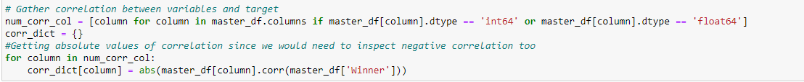
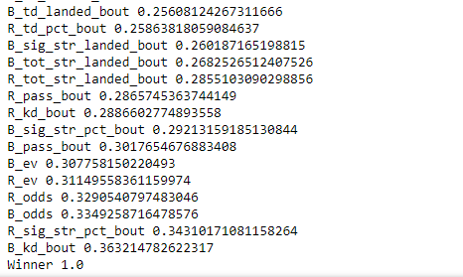
Simple Model
Correlation between variables and wins?
15 variables with correlation of 25% or higher
DummyClassifier
51.75% accuracy
Notes:
The simple model does in fact prove the variables correlate to wins. These are the variables that have a 25% or higher correlation

Slide 24
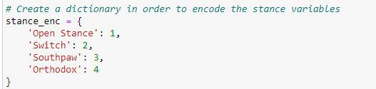
Data Preprocessing
Feature Engineering
(Blue Corner stats) - (Red Corner stats)
Noisy Data
Date, location, weight class, ect.
Columns with predominantly null values
Null values
True nulls? Or zeros?
Categorical values to be encoded
Notes:
The data preprocessing phase has 4 steps, heres what we did and why

Slide 25
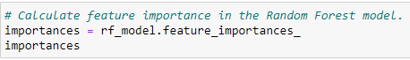
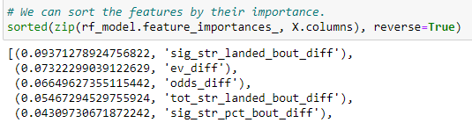
Random Forest Vs. Neural Network
Random Forest
75/25 train/test split
78% accuracy
Neural Network
2 Hidden layers
25 and 12 nodes
25 epochs
Accuracy: 77.93%
Notes:
We compared RF and NN models with the above specs. In the spirit of simplicity we decided to go with RF since it is a little easier to implement. From there we were able to find the top 5 correlating variables to wins with our new cleaned data

Slide 26
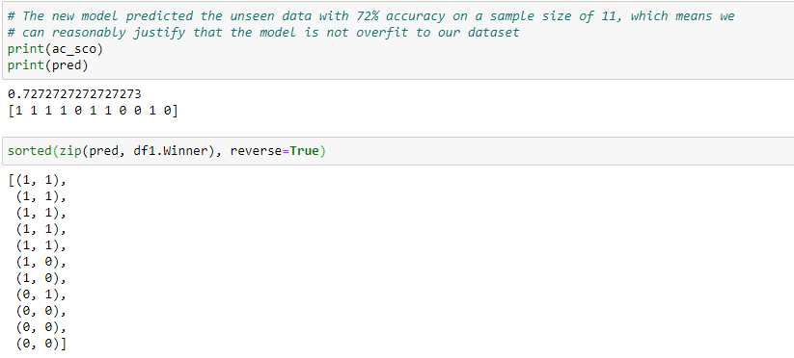
Is the chosen model overfit?
Notes:
We used the RF model trained on our large original dataset on a set of 11 fights unseen to the model. It performed slightly worse but we can confidently say that it is not overfit with this small sample size. Here are the models predictions next to the actual results. Went 8/11

Slide 27
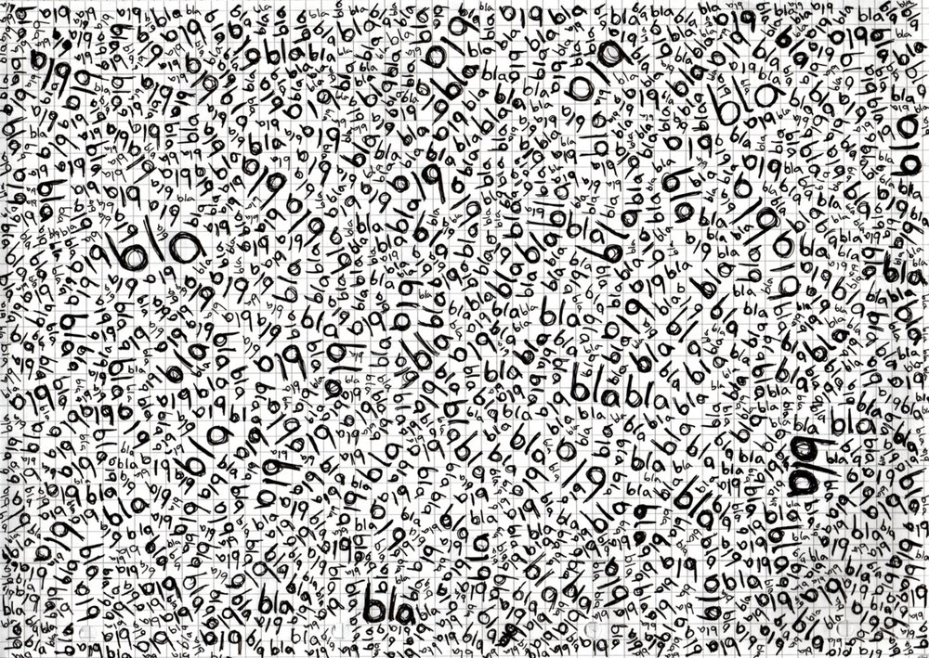

Tableau Time
URL Link
Notes:
Cesar: “Since a picture is worth a thousand words take it away Priti”
( STOP PRESENTING)
Priti: (START PRESENTING)
Cesar (once Priti starts presenting (CLICK))

Slide 28
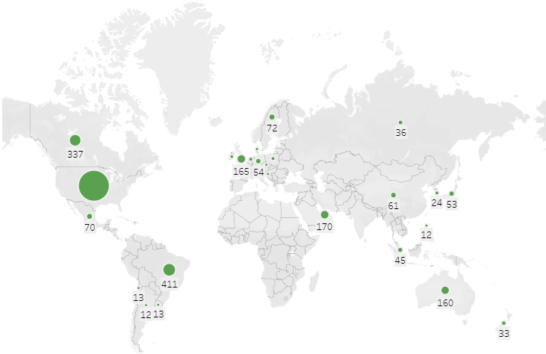
A Global Force Not To Be Reckoned With
URL Link
Notes:
Fun fact: In the early days, UFC fights were held only in a few states, specifically in states where they didn't have athletic commissions to avoid regulation.
The UFC has now expanded to 25 countries; the number of fights held outside the US has increased from 61 in 2010 to 236 in 2019.
(More than 59% of fights were held in the US while Brazil held the most fights outside the US.)

Slide 29
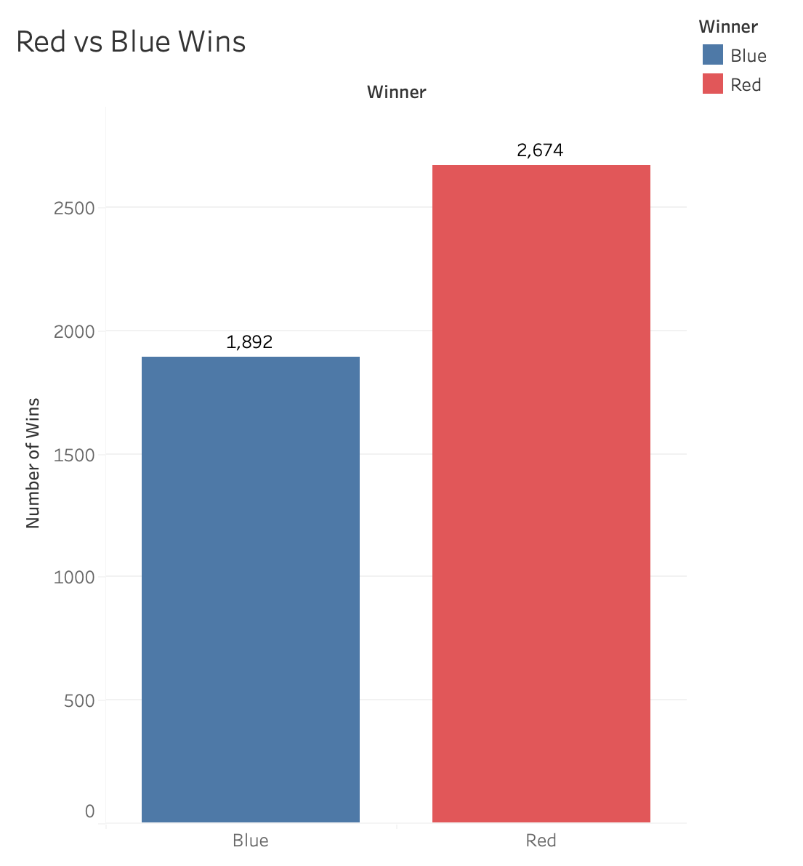
Results
Fighting on the red corner offers a 17% higher chance of winning alone.
Notes:
If we look into the US, we can see that out of the 2,450 fights we analyzed, there is a higher number of red wins vs blue wins. If we look at Brazil, we can see the same thing, more red wins vs blue wings.. In the UAE, same thing again.
Overall, it can be concluded that Red Fighters have a higher (58.6%) chance to win, while Blue Fighters have a lower (41.4%) chance to win. Thus, fighting on the red corner offers a 17% higher chance of winning alone.
Now, let's take a look at which specific features play the biggest role in predicting a win..

Slide 30
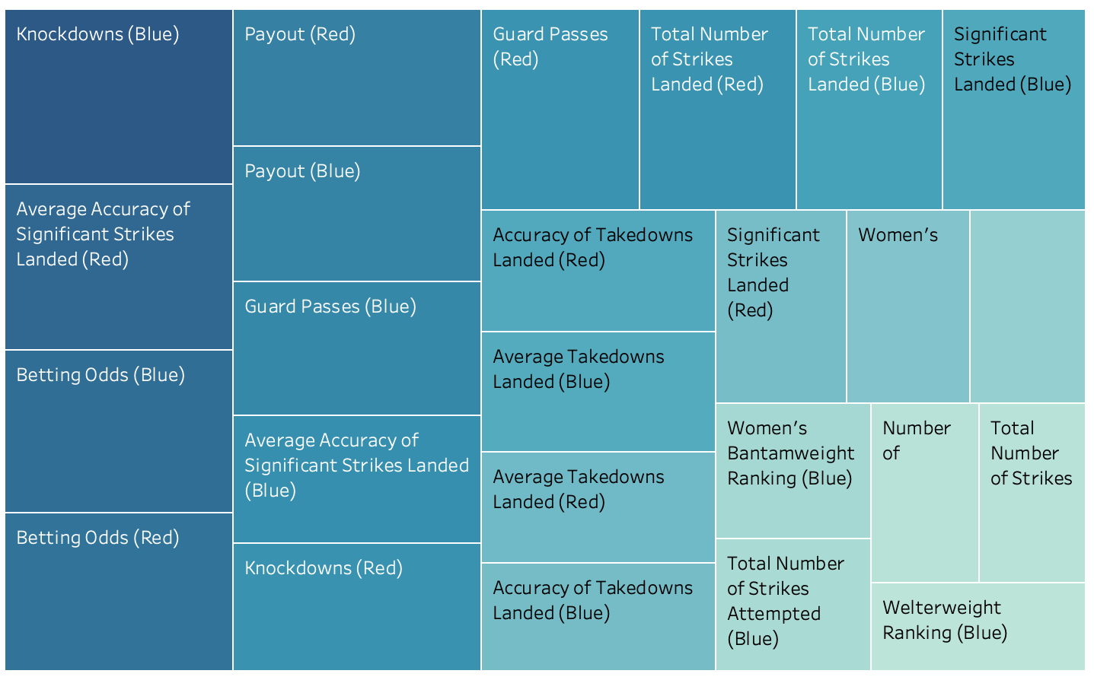
Top 25 Features
Notes:
Out of the 137 features we analyzed, this tree map showcases the top 25 that carry the strongest correlation to winning. Due to the nature of our dataset, our metrics are split into those of the red fighter vs the blue fighter. You can see the strongest (also the most dense in color) at the top left and we see the weakest metric as we make our way down to the bottom right. We’ll get into these definitions and meanings in a moment, but you can hover over each block to find the further details and its correlation metric.

Slide 31
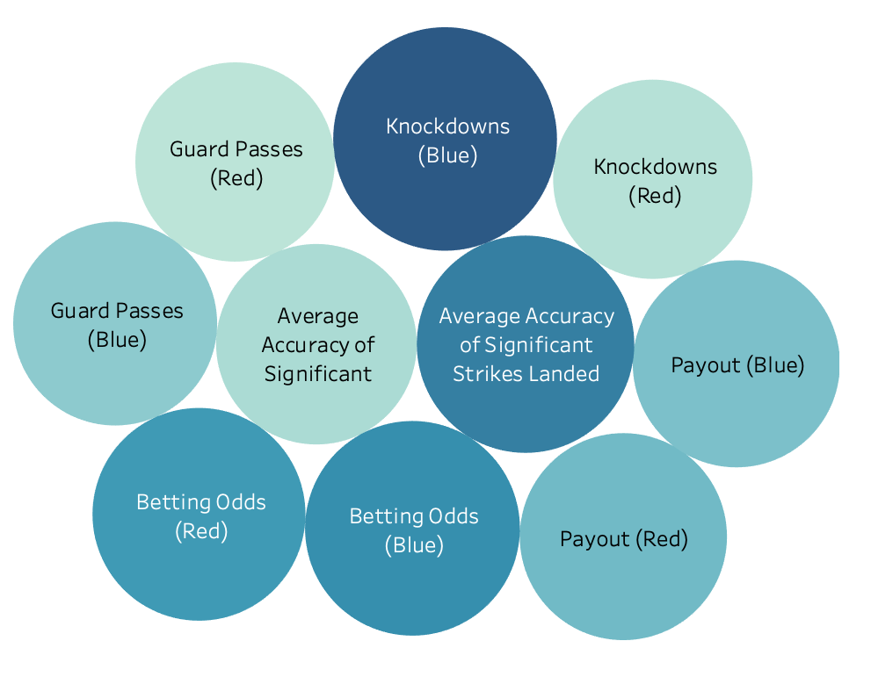
Top 10 Features
Notes:
To narrow it down further, here are the top 10 strongest features. As you can see, these bubbles are weighted by color and by size. The deeper the color and the bigger the size.. the stronger the correlation, but as you can see here, the difference between these bubbles are slight, so it is safe to say that according to our analysis, these top 10 are all pretty important.

Slide 32
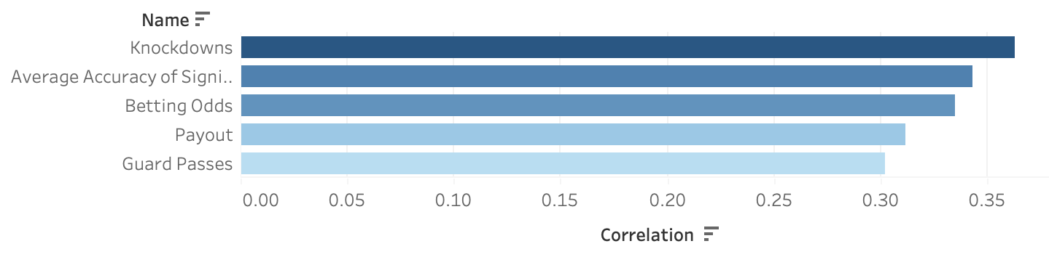
Top 5 Features
Notes:
And finally, to answer our golden question.. what are the top 5? To do this, I coupled red and blue metrics that come in side by side so here we have a summary of the overall top 5!
At #1, we have knockdowns, and specifically the average number of knockdowns per fight
At #2, we see significant strikes per fight (both of these top 2 features encompass some of the more typical statistics that come to mind, like reach, strength, and weight)
At #3, we have the betting odds - which we define as a probability statistic made by leading betting companies
At #4, we have payout, which references the fighter that has the higher financial incentive or “payout” for winning
And lastly, at #5, we have the average number of guard passes in a fight.
There you have it! The top 5. Back to you Cesar for the remainder of our results.

Slide 33
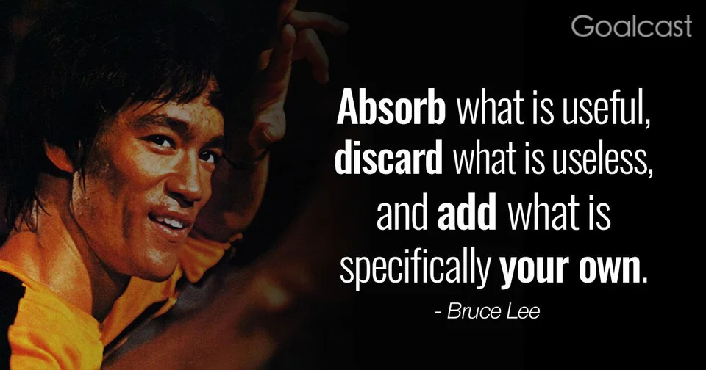
Results I
1. What are the top 5 fighter metrics that contribute to winning a UFC match?
Average number of knockdowns per fight
Significant strikes per fight: Strikes at a distance and power strikes in the clinch and on the ground
Betting Odds: Human probability statistic made by a leading betting company or odds compiler
Payout: The fighter that has the established higher financial incentive or payout for winning
Average number of guard passes in a fight: On the ground which the fighter that has a statistically better chance at entering a more dominant position (normally accomplished using wrestling or brazilian jiu jitsu techniques)
Notes:
Cesar: “Thank you, Priti for answering the first of 5 questions. On to the next..
(CLICK)

Slide 34
Results II
2. Which of the fighter metrics carry more weight than the others?
Significant strikes landed per fight
3. How much do biometric physical factors, i.e. age, height and weight, affect the outcome of the match?
Reach is the most important biometric factor
4. Does having a higher rank predict the outcome?
Not necessarily
5. Do the number of win streaks necessarily predict a higher chance of winning?
No they do not
Notes:
Cesar:
“2. Which of the fighter metrics carry more weight than the others?
The fighter with the highest average number of significant strikes landed per fight metric typically will be your winner.
3. How much do biometric physical factors, i.e. age, height and weight, affect the outcome of the match?
Since a high volume of accurate significant strikes is the most important contributing factor, a fighter's reach benefits his or her ability to deal these significant strikes from a distance the most.
4. Does having a higher rank predict the outcome?
Although it was the 3rd significant factor in our simple model, in our refined final model it became the 34th most important contributing factor. This still leaves it in the upper 25th percentile but not top 5.
5. Do the number of win streaks necessarily predict a higher chance of winning?
As the 26th most important factor having a win streak unfortunately does not necessarily contribute to you winning your next match.”
(CLICK)

Slide 35
Future Analysis & What we would do differently
Test a wider variety of models
KNN
Decision Tree
Test variable correlations to betting payouts
Create a fighter database in order to compare potential future matchups
Store data in JSON structure
Notes:
Cesar: “Andrew for what else we could have done differently...”
Andrew:
In future analyses, we could test a wider variety of models
We could also test variables as related to betting payouts
Something we might do differently is create a fighter database and store results in JSON structure in order to predict future matchups
(CLICK)

Slide 36
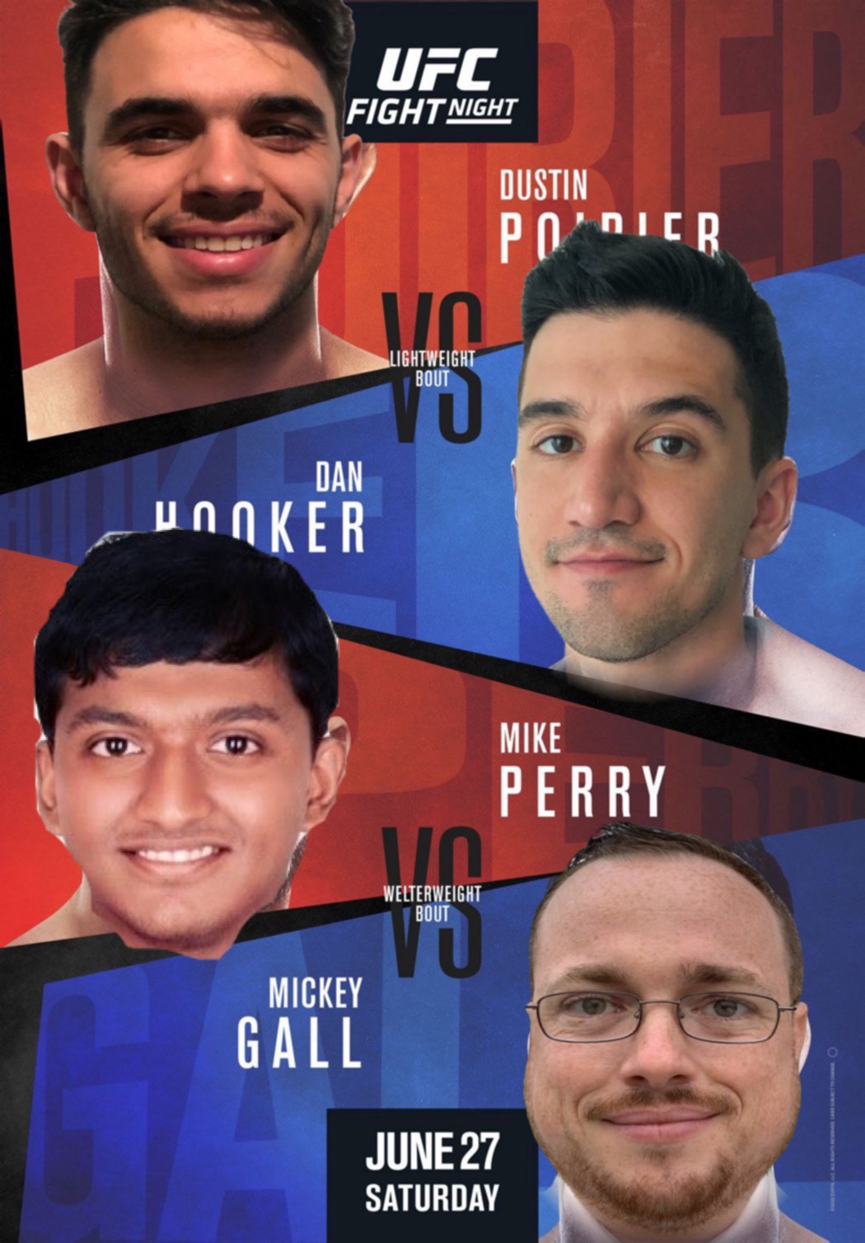
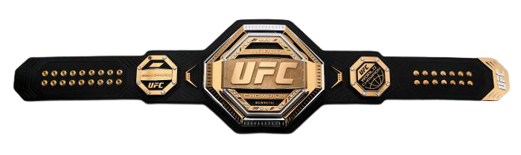
WHO WILL WIN?
PLACE YOUR BETS!
GONZALO GARCIA
DIMAS
TORRES LLORCA
TEJAS NANAWARE
JOSH FARMER
Disclaimer:
This analysis is for academic purposes only and it is not intended to be used to make any sort of betting or gambling decisions.
April 13
TUESDAY
Notes:
Cesar:
“Who do you think will win this next upcoming UFC match?......Now that you know what it takes to win, time to throw in your bets!”
… … … …
… … … ...
“THANK YOU!
*mic drop*

Slide 37
Source
Poll: Best Base?
Folkstyle Wrestling Produces UFC Champions.
ESPN MMA Base Viz

